Slide 1

SHRI VISHNU ENGINEERING COLLEGE FOR WOMEN
PROJECT TITLE: E-LEARNING SYSTEM
BATCH NO: A4
20B01A0504 - AKSHITA BHUPATHIRAJU
20B01A0533 - CHINTAPANTI KAVYA PEDDINTLU
20B01A0545 – GANAPAVARAPU NAGA DEVIKA
20B01A0562 - JAMI TEJASWINI SAI PRASANNA
GUIDE NAME: MRS P.R.SUDHA RANI

Slide 2
AGENDA
Introduction
Abstract
Modules
Design(UML Diagrams)
Implementation(Screen shots)
Testcases

Slide 3
INTRODUCTION
E-learning is a web-based application which offers online content for the students to enhance the quality of learning. With the rapid growth of e-sources a large variety of courses provides a wide range of knowledge and information. E-learning fulfills the thirst of knowledge and offers online content that can be delivered for the learner at anywhere and anytime to a wide range of E-learning solution while compared with traditional learning system. E-learning can enrich the skills in students by the means of self-study. E-learning is very helpful to meet the learning style or needs of students and improve the efficiency and effectiveness.

Slide 4
ABSTRACT
E-learning consists of all the courses that provides students to learn and acquire more knowledge. Our platform provides interview questions along with the courses that are needed and very helpful for the learners in enhancing their skills and also in fulfilling their jobs. The interview-based topics and questions help the learners to learn efficiently and make a self-assessment on their skills. Most of the learners seek for the interview questions which are not available in the same website in which they are learning the course. E-learning is very helpful to meet the learning style & need of students and improve the efficiency & effectiveness.

Slide 5
MODULES
Input Modules
Student Registration and Login
Admin Login
Course
Lesson
Feedback
Interview Questions
Output Modules
Student List
Course Detail
Lesson Detail
Interview details

Slide 6
INPUT MODULES
STUDENT REGISTRATION & LOGIN:
Through this module the student can register and login into the website to enroll the corresponding course and he will be redirected to student dashboard.
ADMIN LOGIN:
Through this module the admin can login into the admin dashboard and can add the courses, lessons and interview questions into the website.
COURSE:
Through this module the student can learn a particular course by enrolling it.

Slide 7
LESSON:
Through this module, the student can learn a particular course by completing all the lessons that are included in that course.
FEEDBACK:
Through this module, the student can give the feedback about the website and the feedback will be visible in the homepage.
INTERVIEW QUESTIONS:
Through this module, the student can prepare for the interview and he can learn the questions related to a particular subject.

Slide 8
OUTPUT MODULES
Student List:
In this module, there will be the list of all the students registered.
Course Details:
In this module, all the courses that are available will be visible.
Lesson Details:
In this module, all the lessons that are included in the course will be visible.
Interview Details:
In this module, all the interview questions related to the course will be visible.

Slide 9
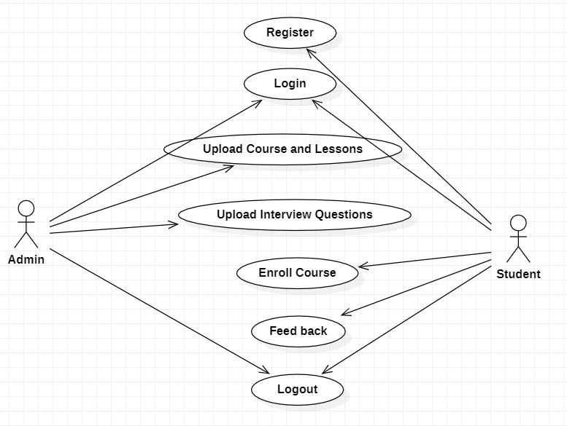
DESIGN 1

Slide 10
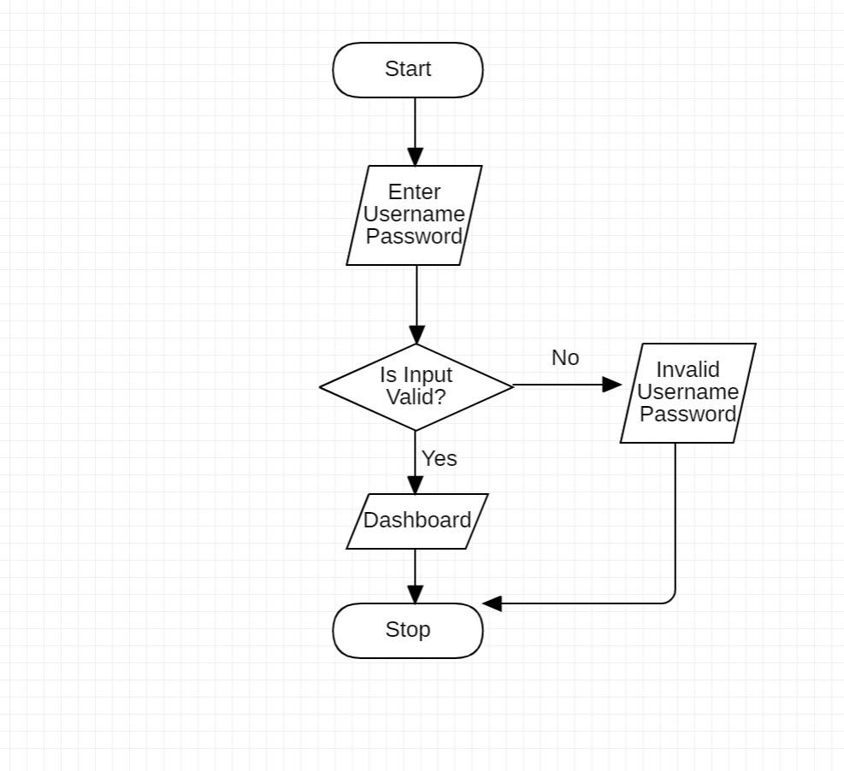
DESIGN 2

Slide 11
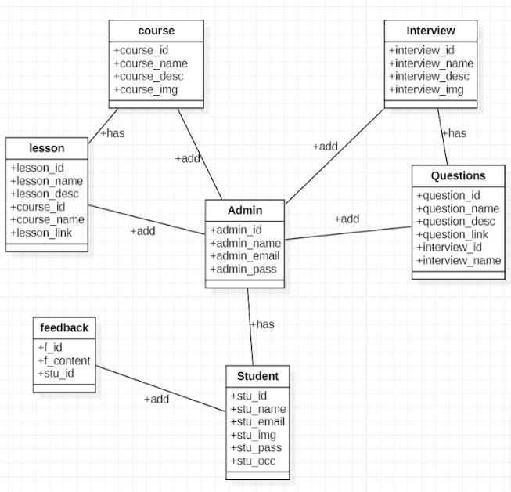
DESIGN 3

Slide 12
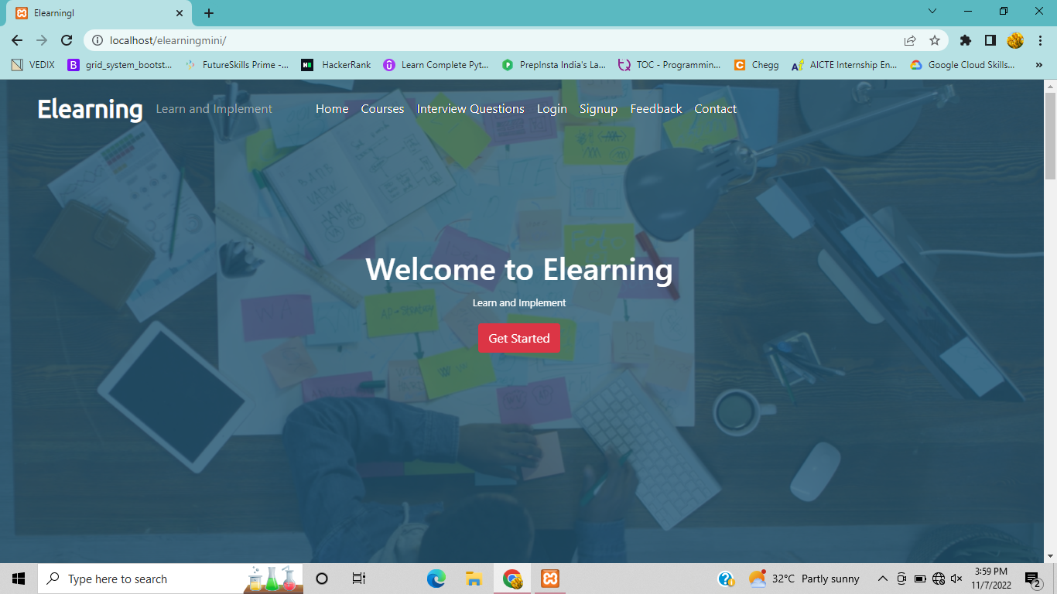
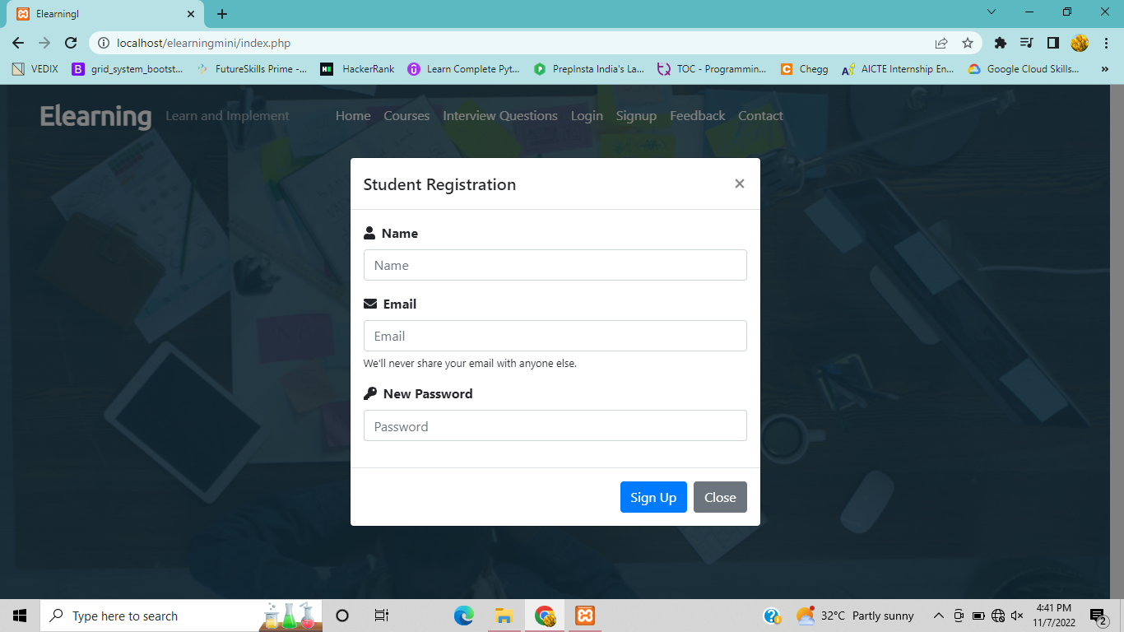
IMPLEMENTATION

Slide 13
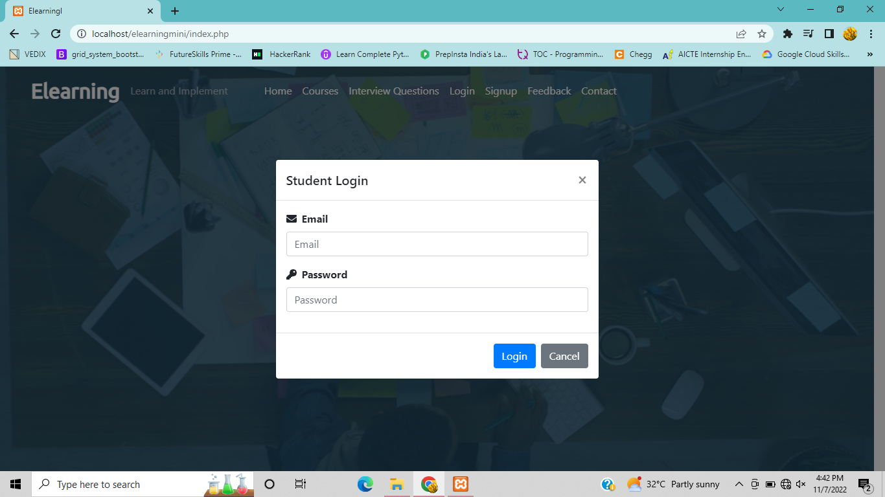
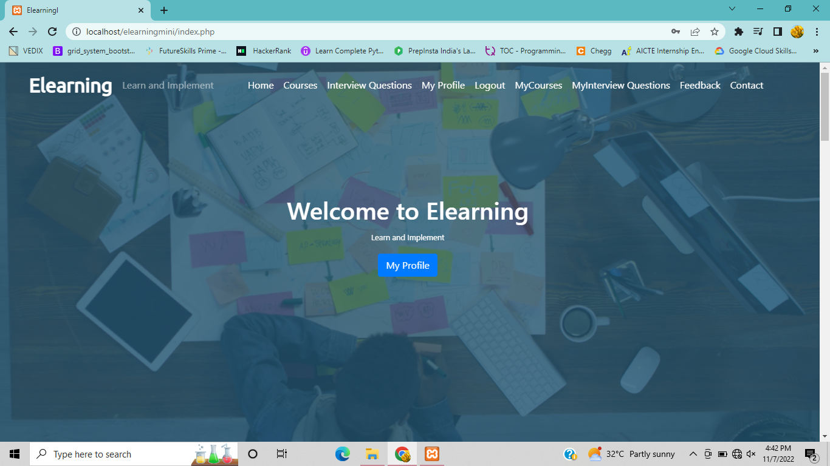
-

Slide 14
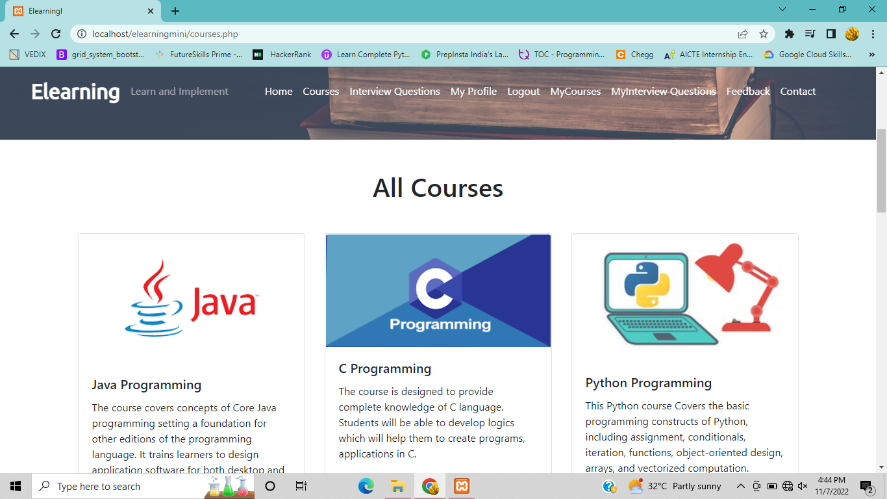
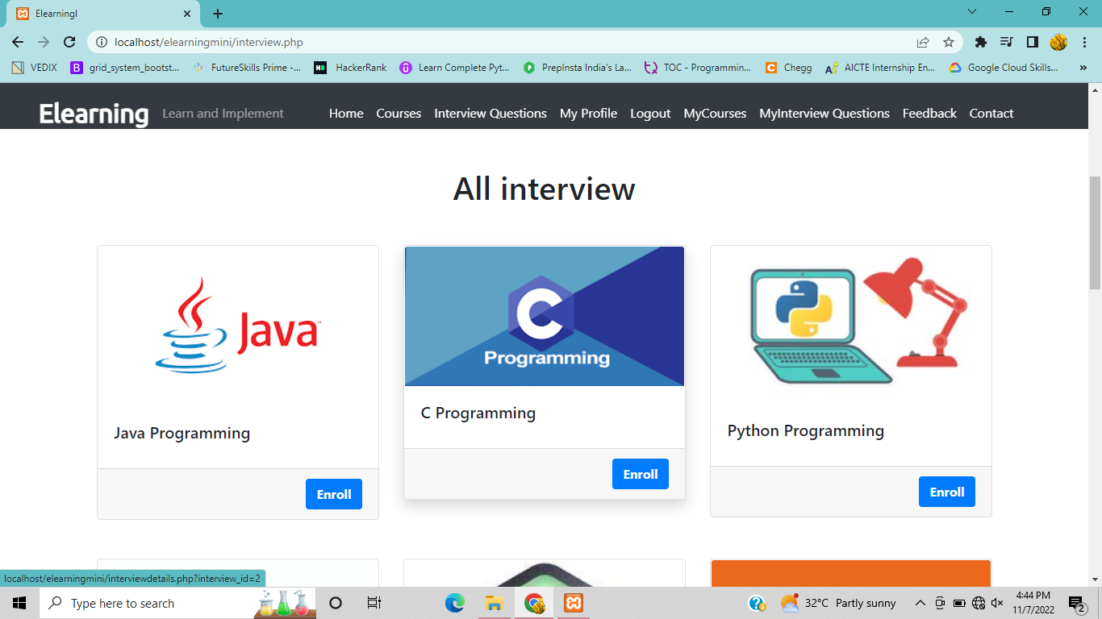

Slide 15
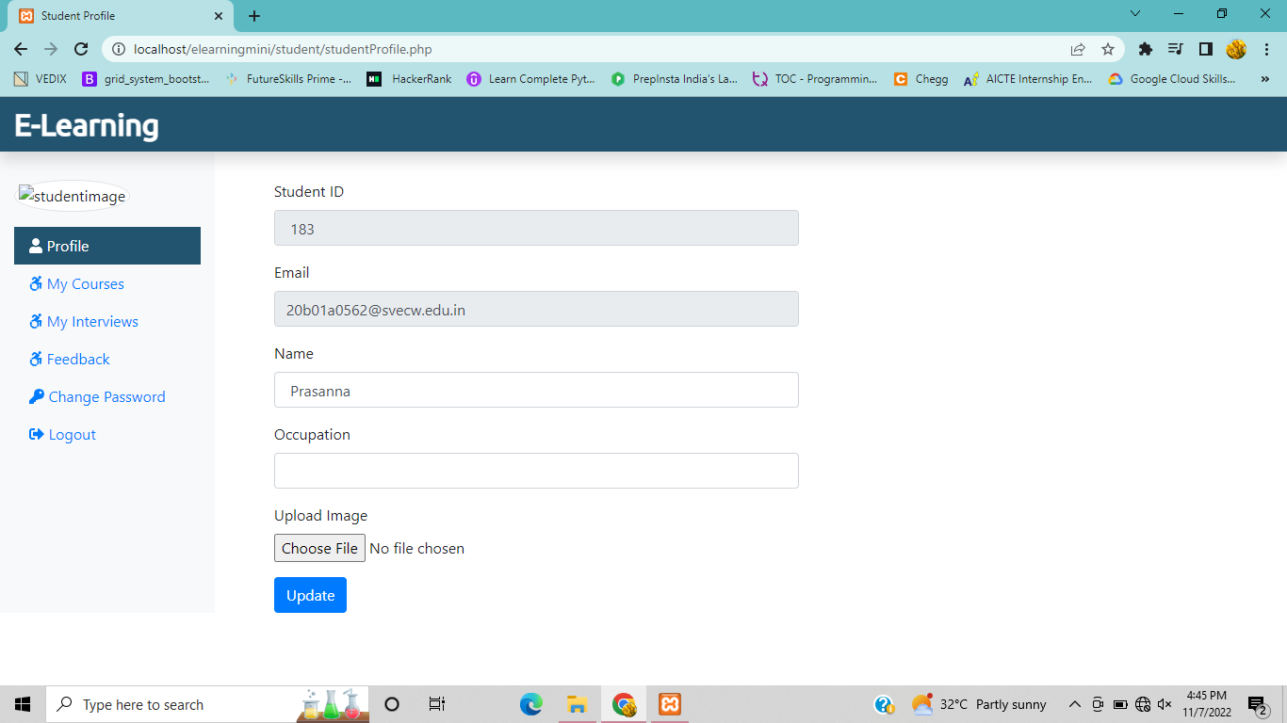
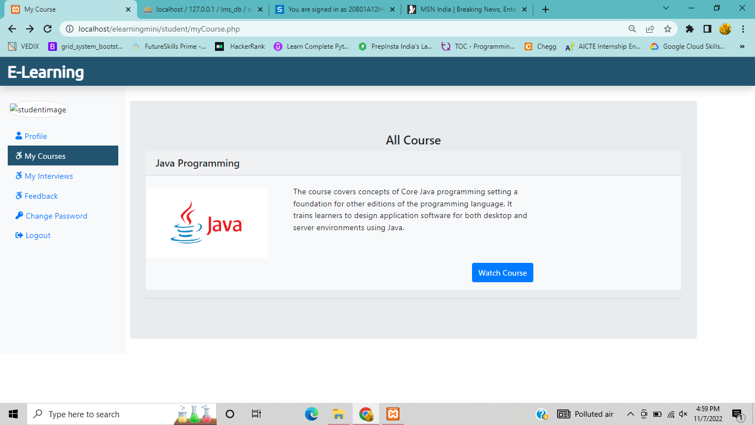

Slide 16
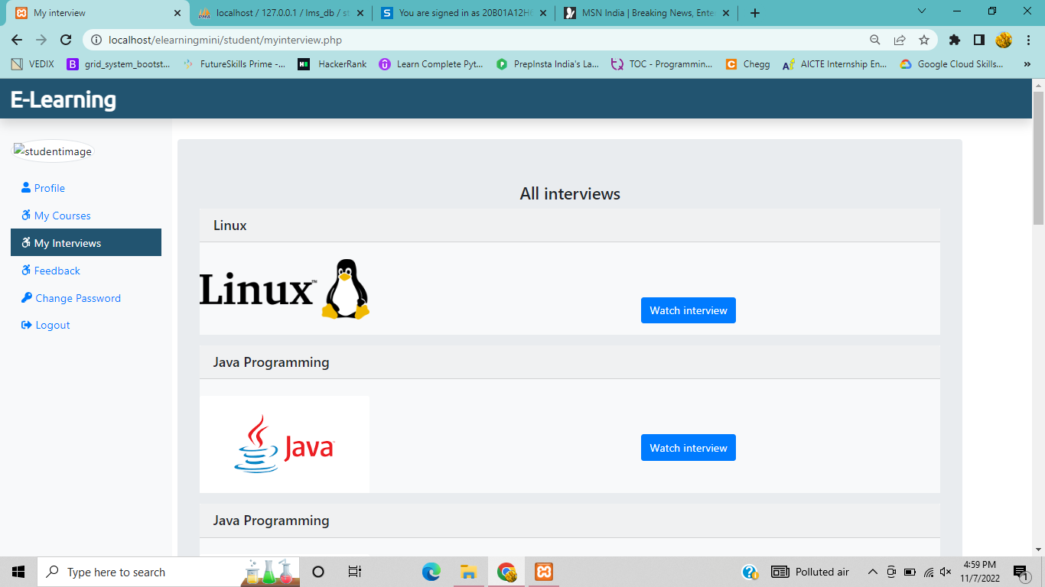
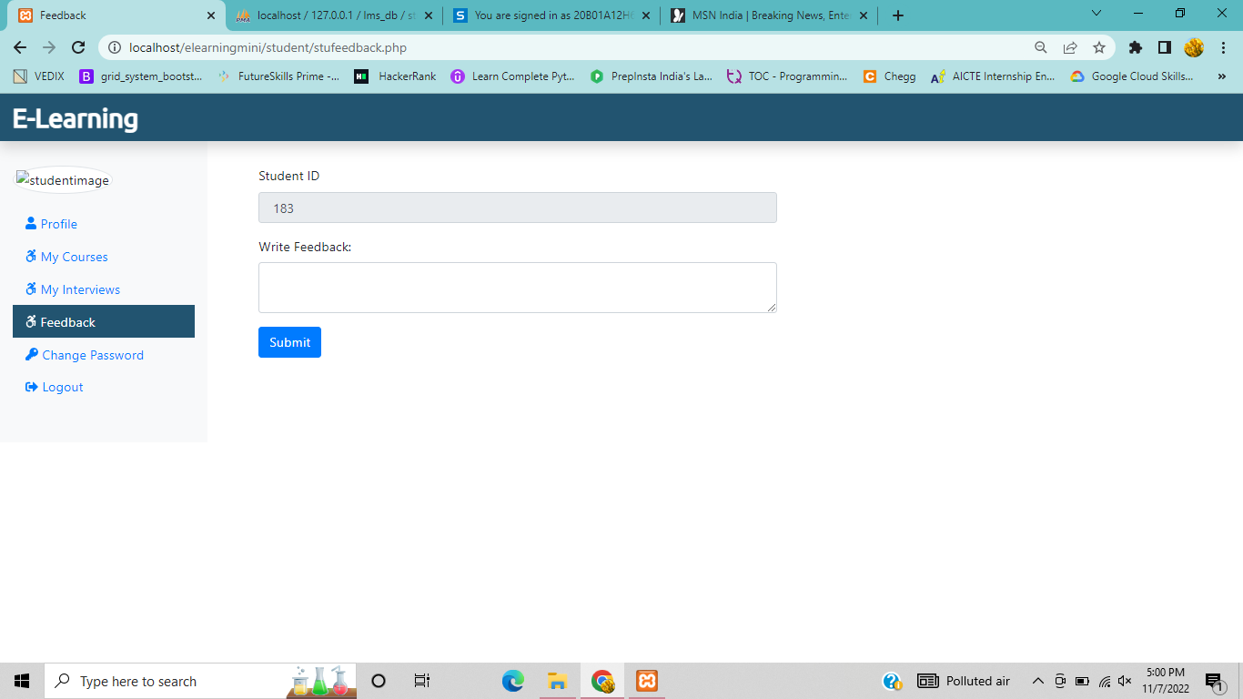

Slide 17
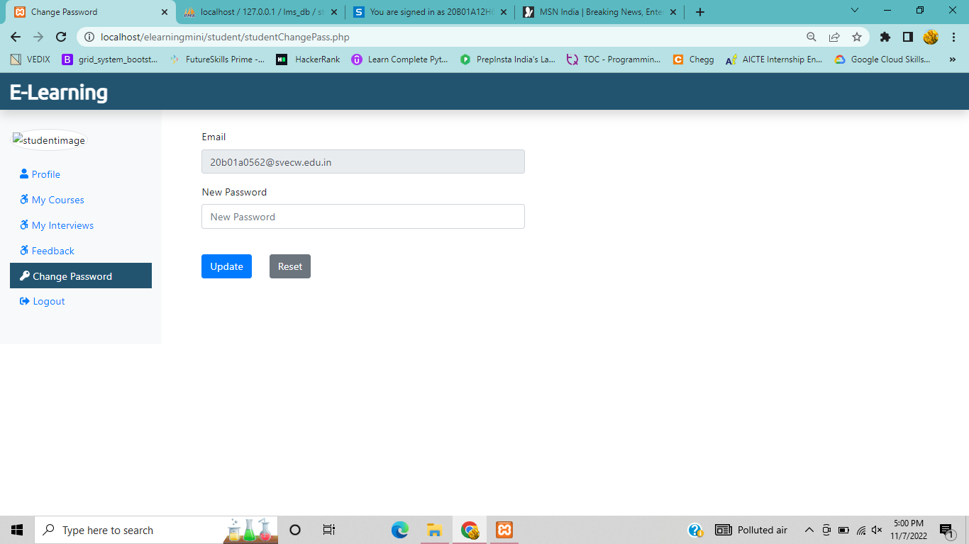
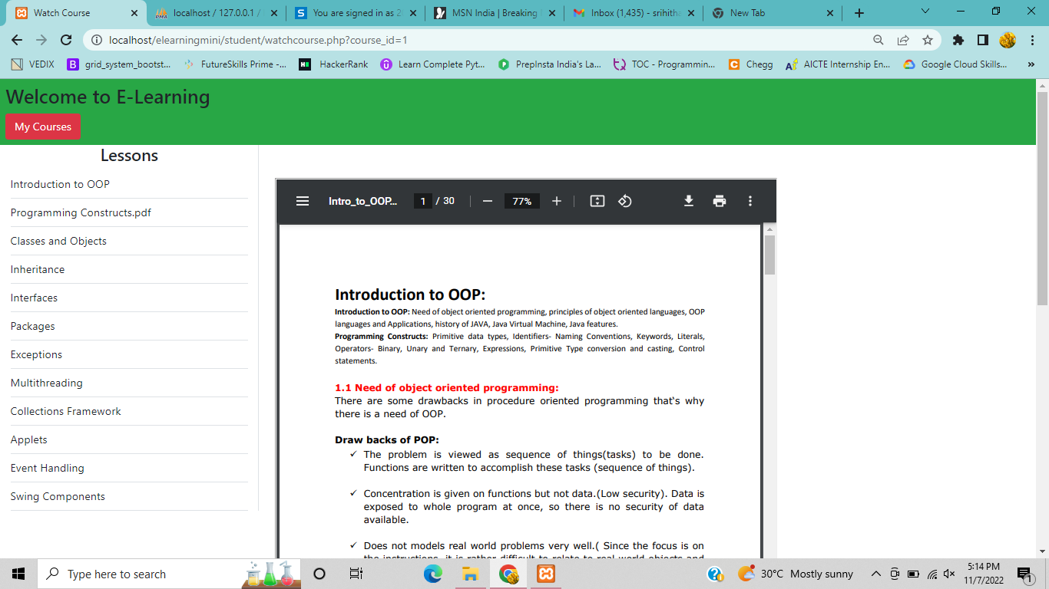

Slide 18
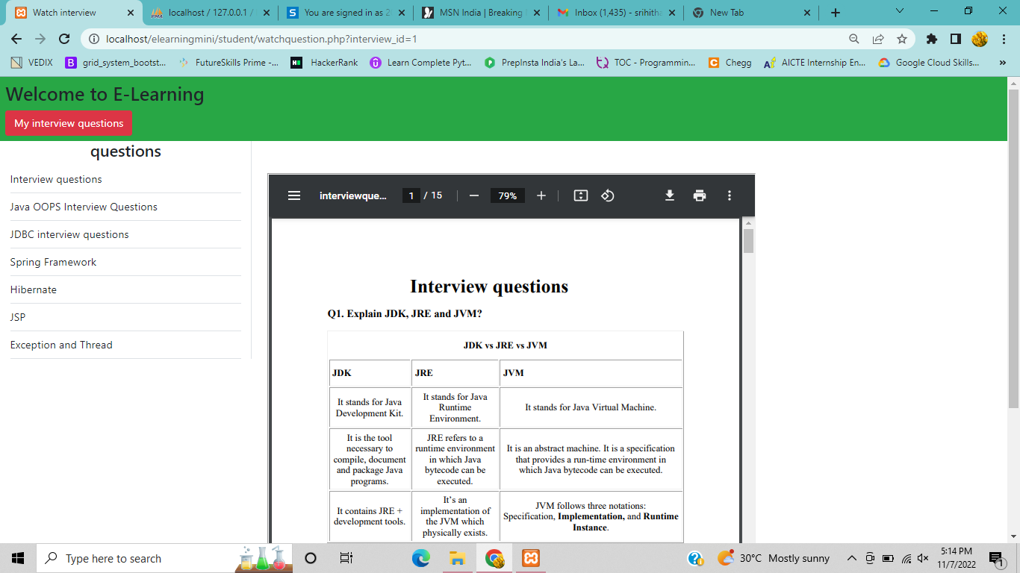
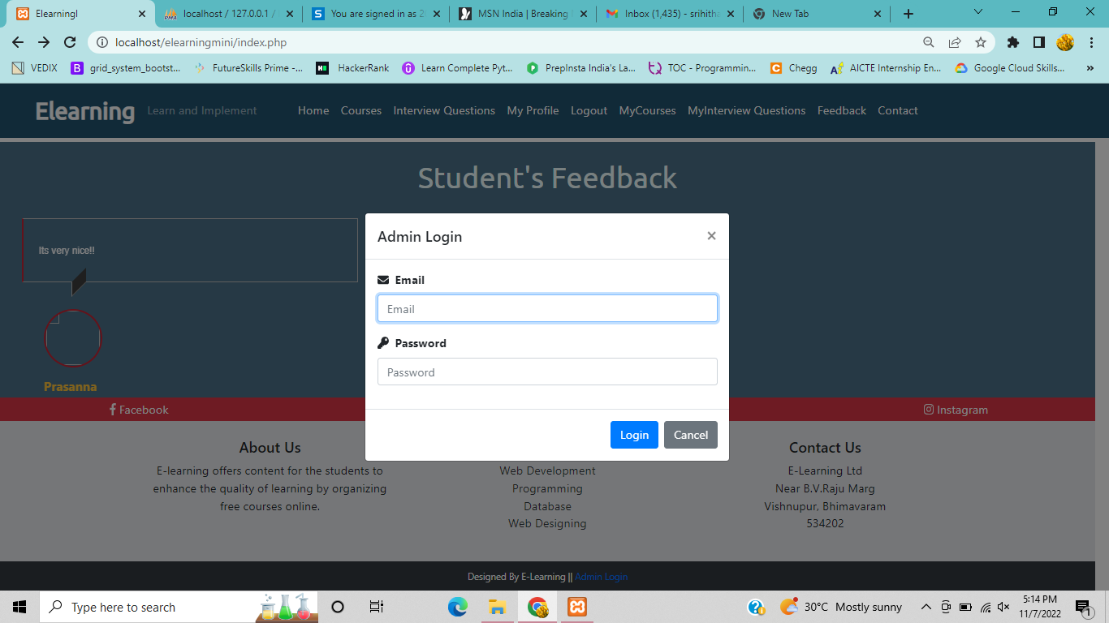

Slide 19
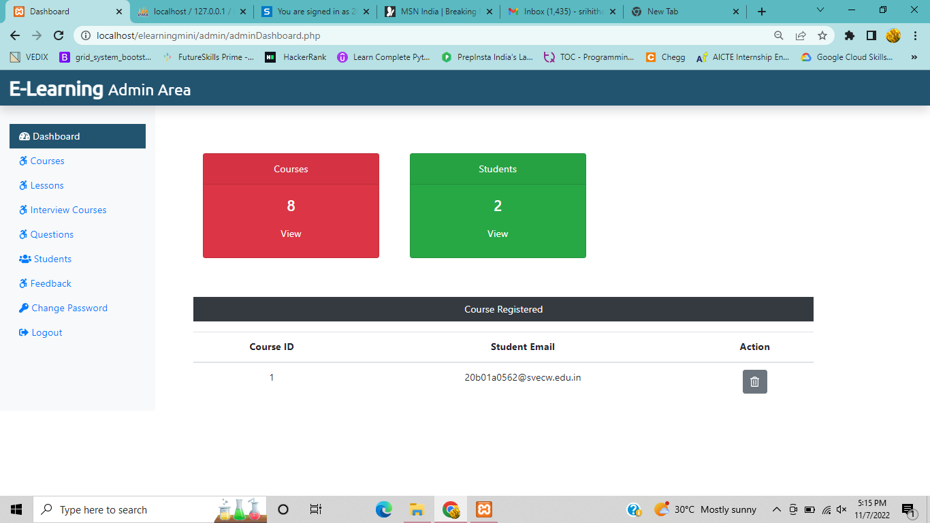
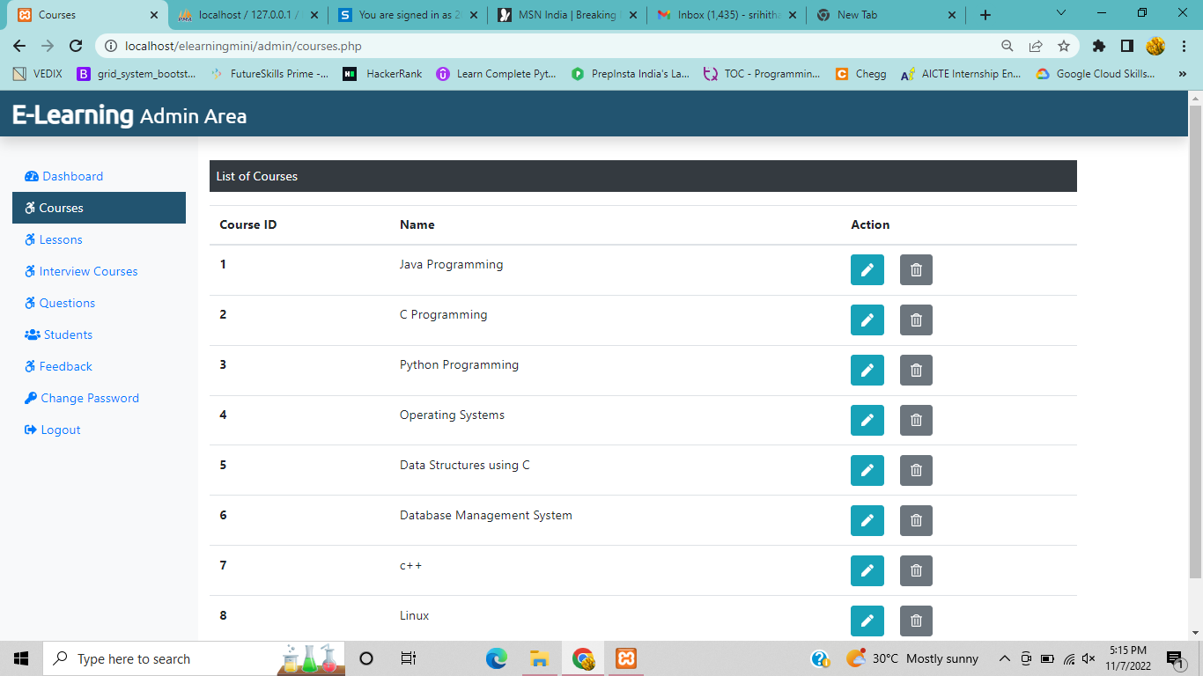

Slide 20
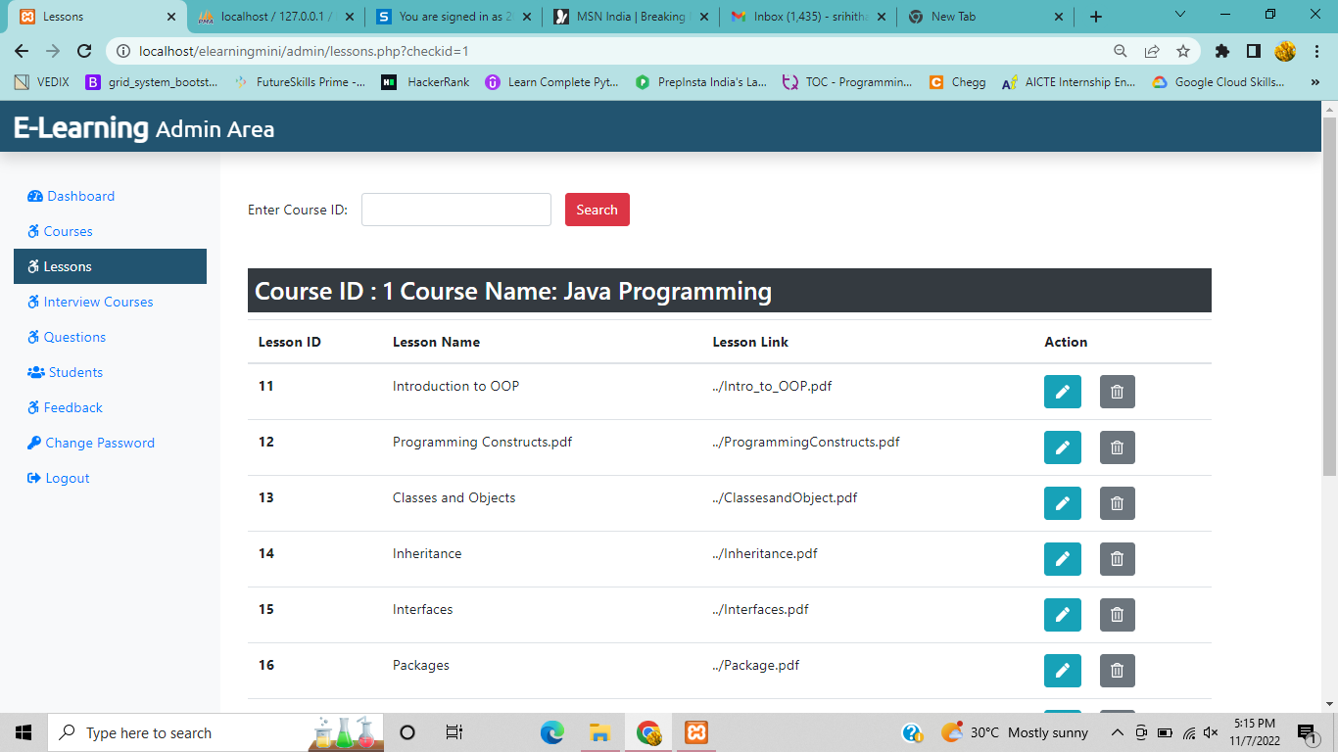
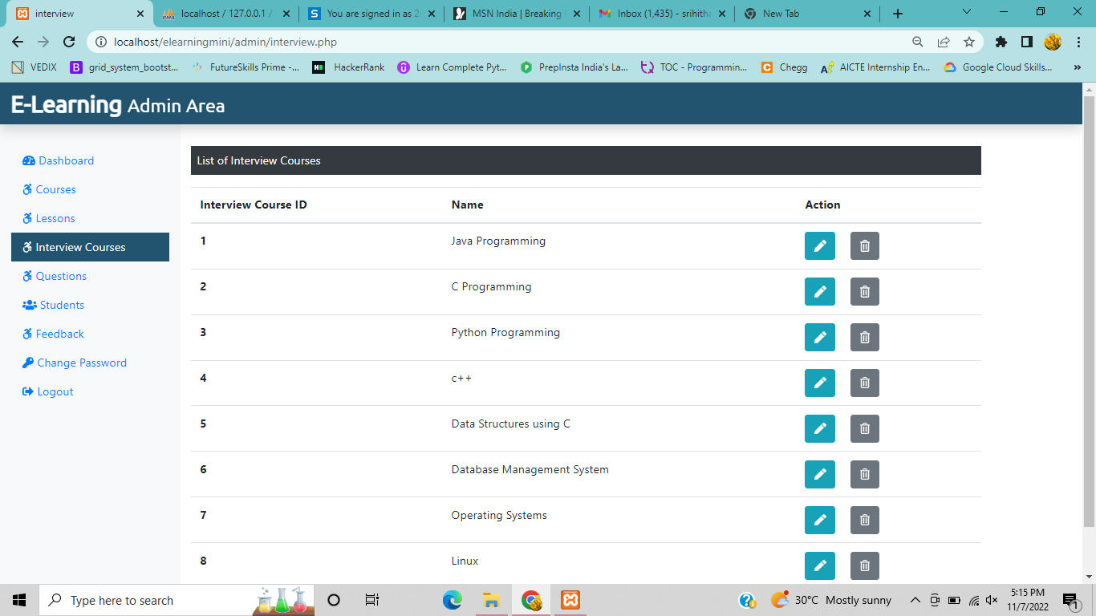

Slide 21
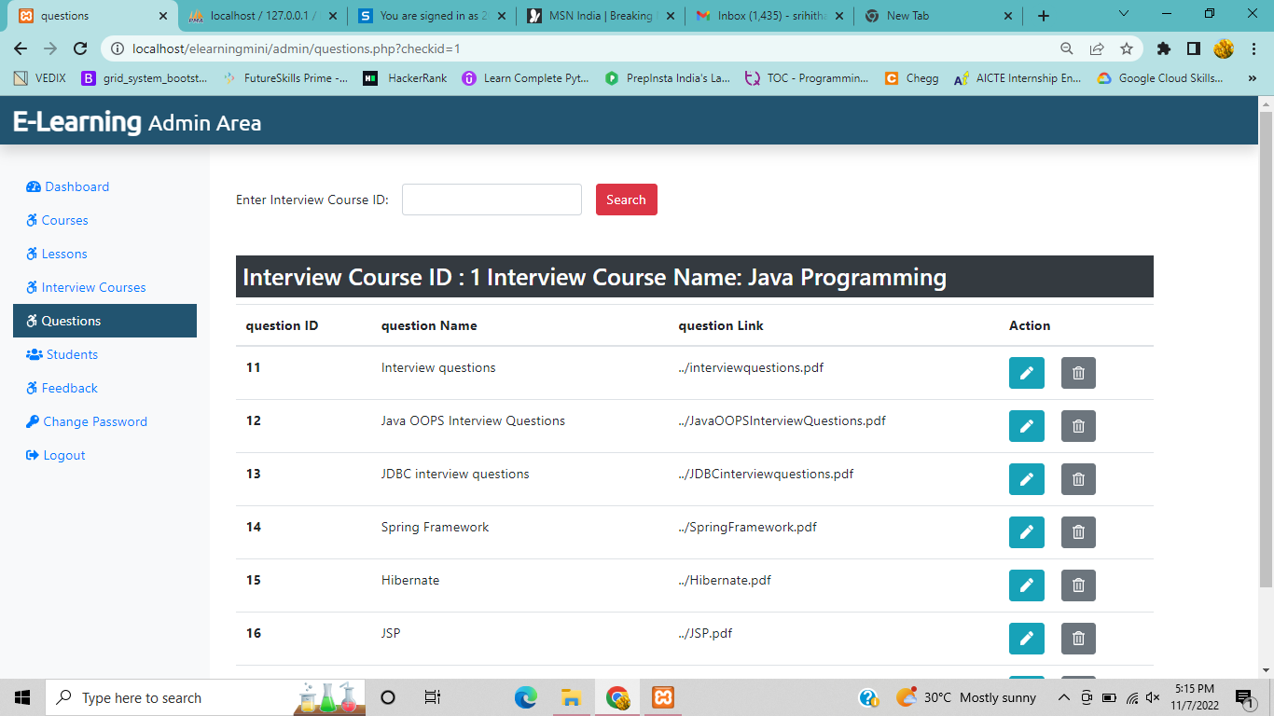
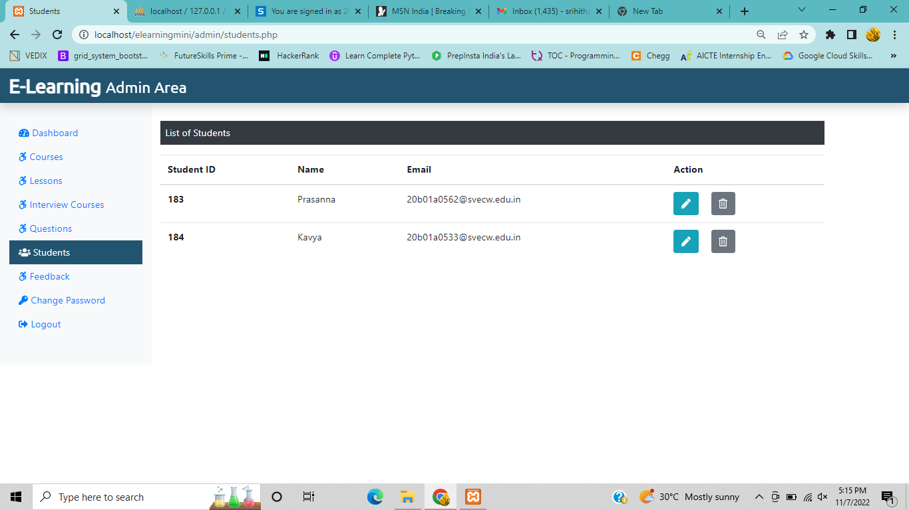

Slide 22
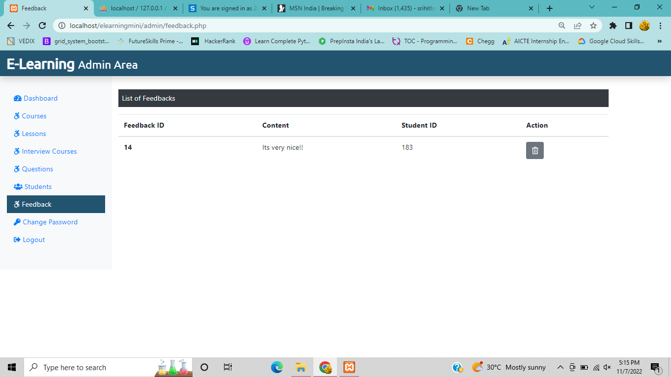
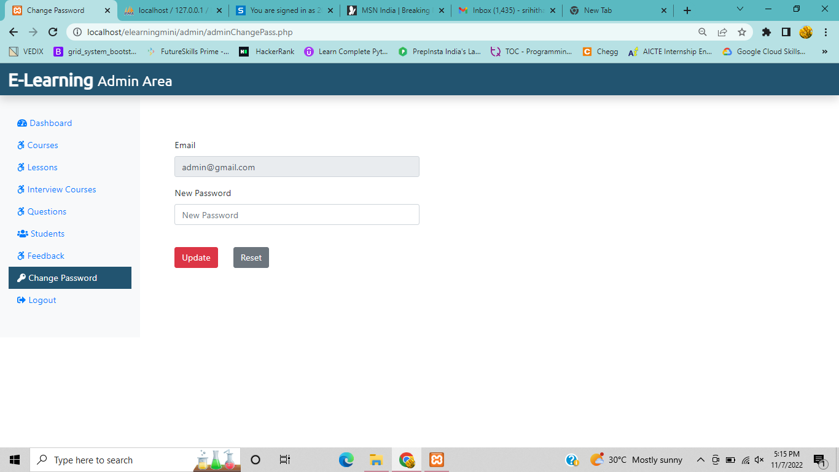

Slide 23
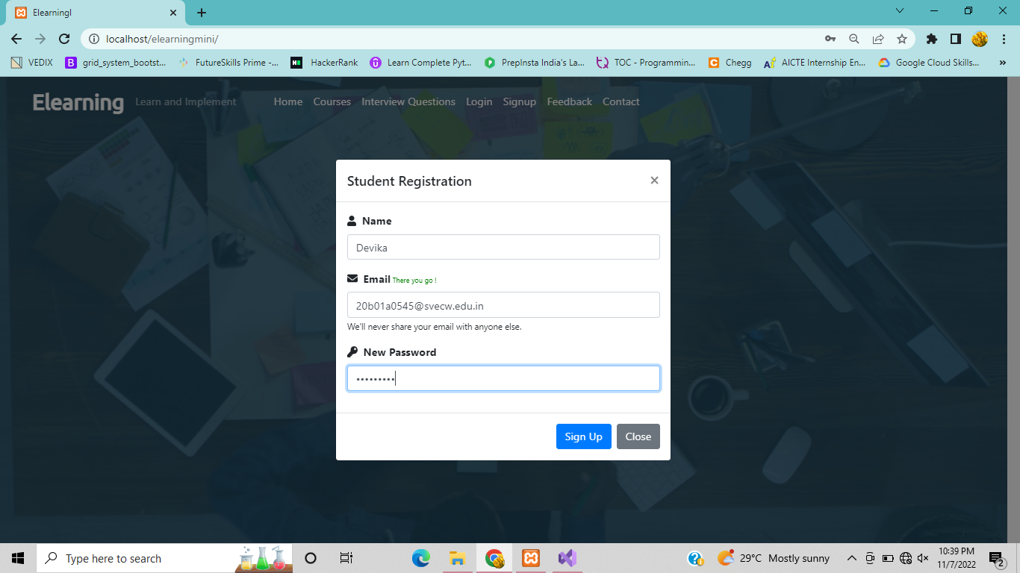
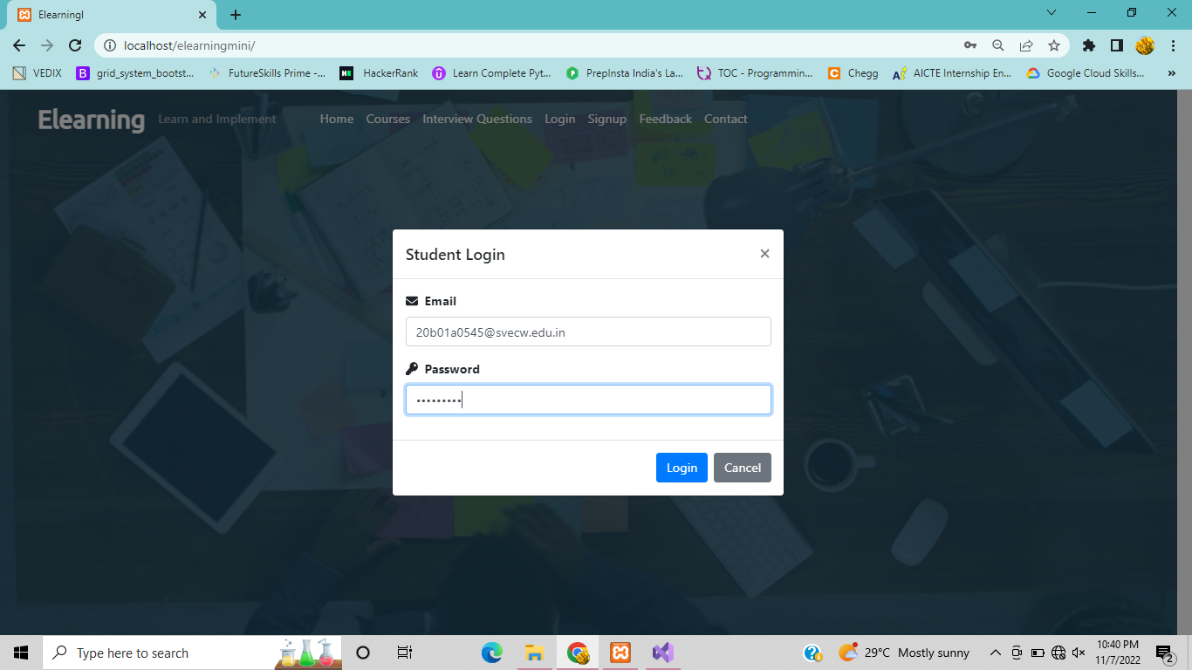
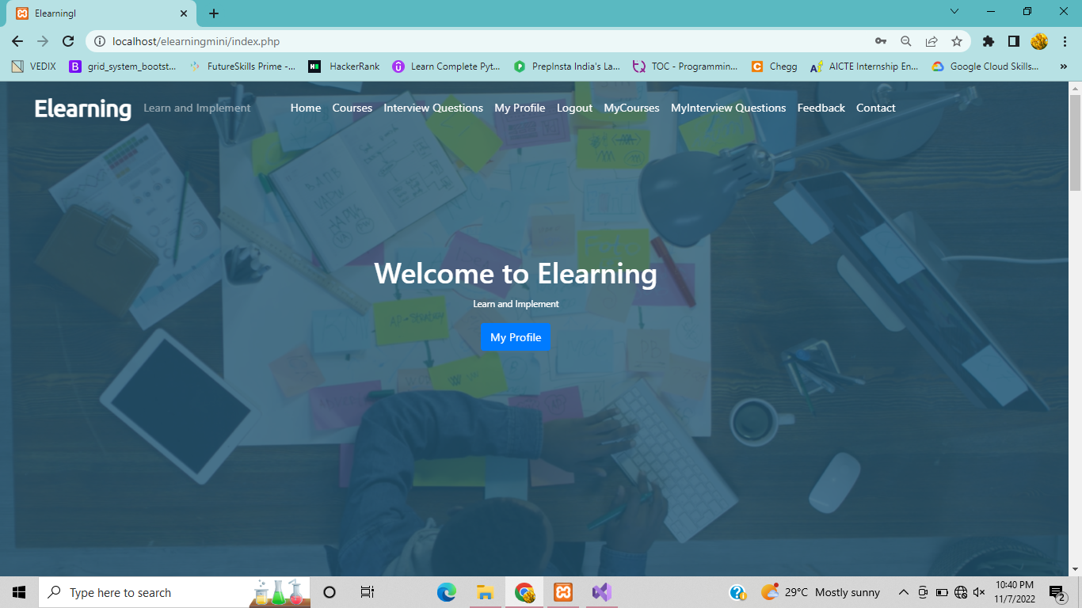
Test Case 1

Slide 24

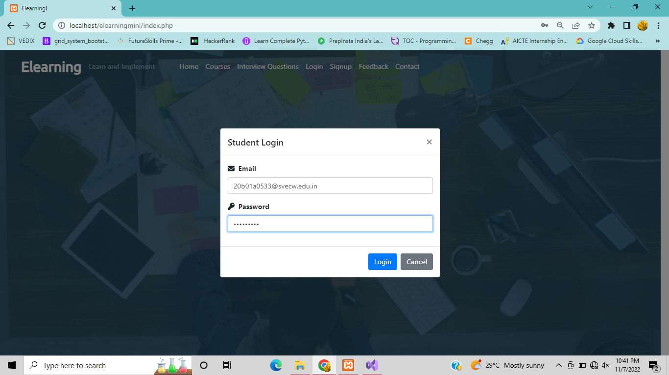

Test Case 2

Slide 25


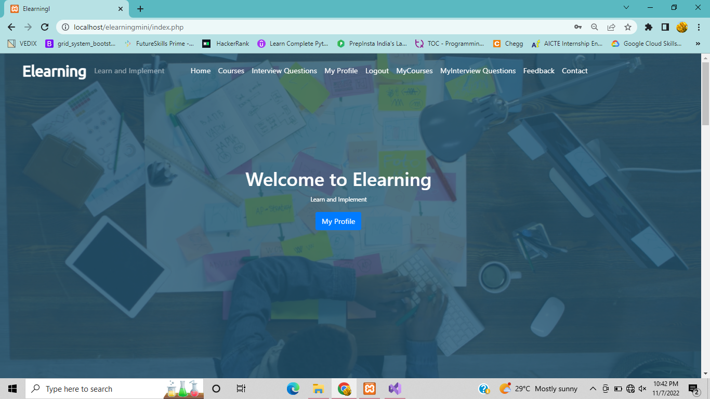
Test Case 3

Slide 26


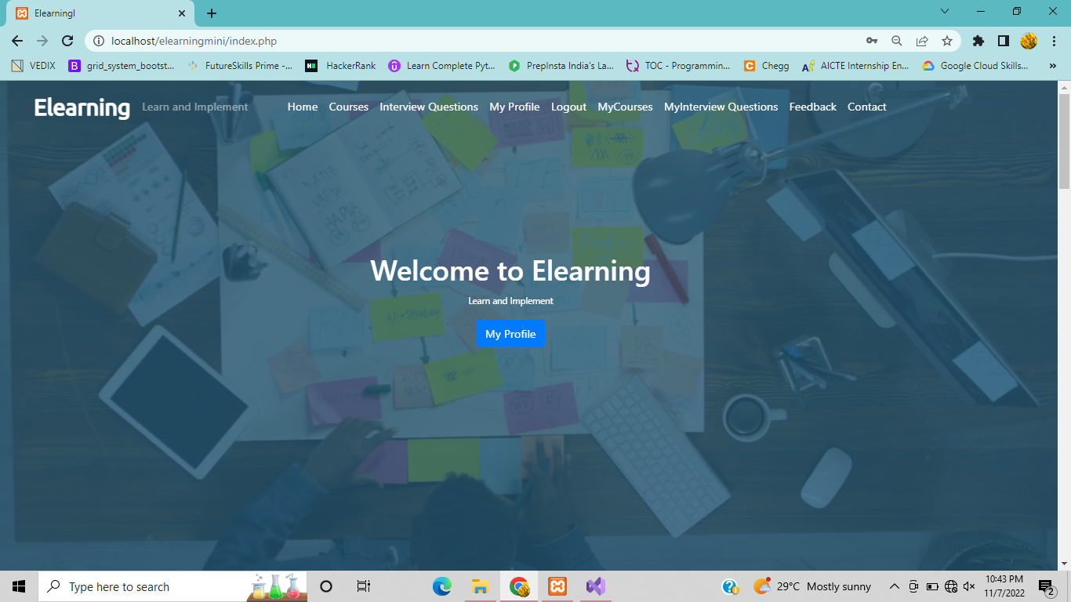
Test Case 4

Slide 27


